Slide 1





Optical Mark Recognition
Prepared by : Mohamad Abdel Rahman - Dana Mrad - Ibrahim Abou Zaher
Date : 14 – 10 -2023
Instructor : Dr. Lama Affara

Slide 2
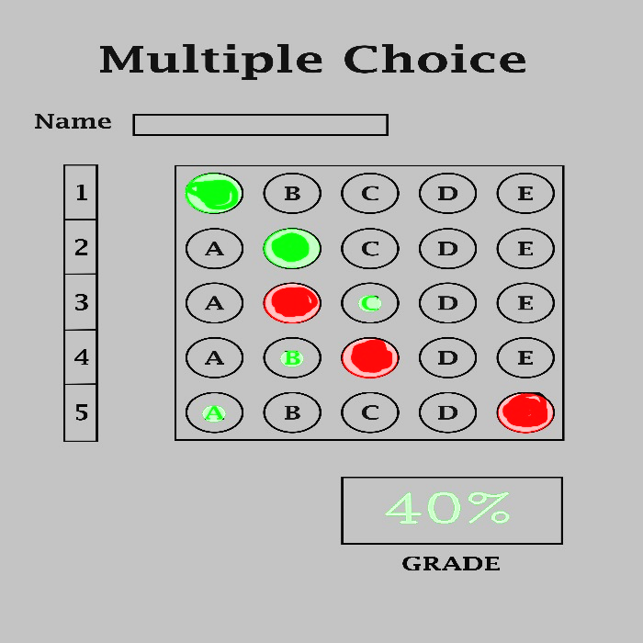
What is Optical Mark Recognition
Definition:
OMR is a technology to read and interpret marked data on printed documents, like checkboxes or bubbles.
Functionality:
It scans, processes, and interprets human-made marks for tests, surveys, and forms.
Working Principle:
OMR systems use specialized software and hardware to detect and analyze marks on paper.
Applications:
SAT exam, University entrance exam, course evaluation ….
Benefits:
Fast, accurate, cost effective and easy to implement and support

Slide 3


Image Processing Steps

Slide 4
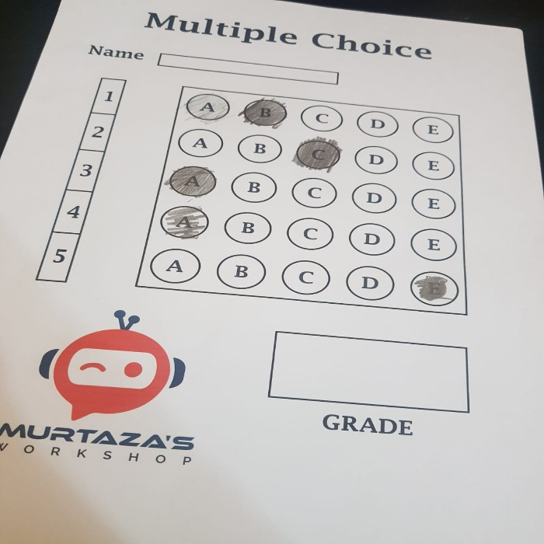
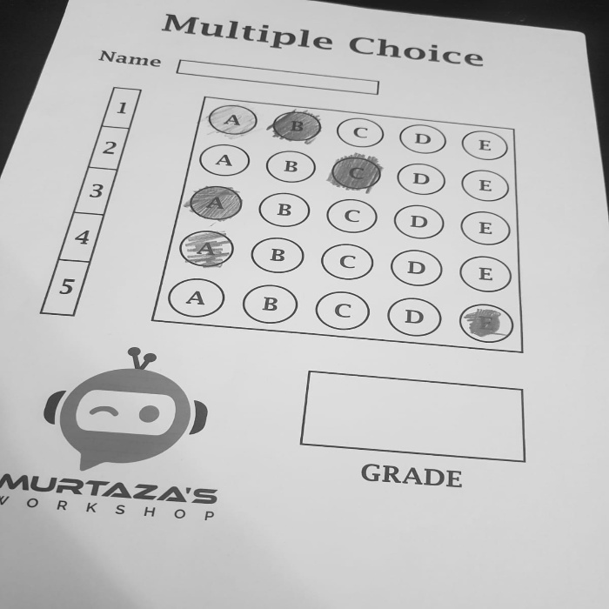
Original Image
Gray Scale

Slide 5

Gray Scale
Blurred image

Slide 6
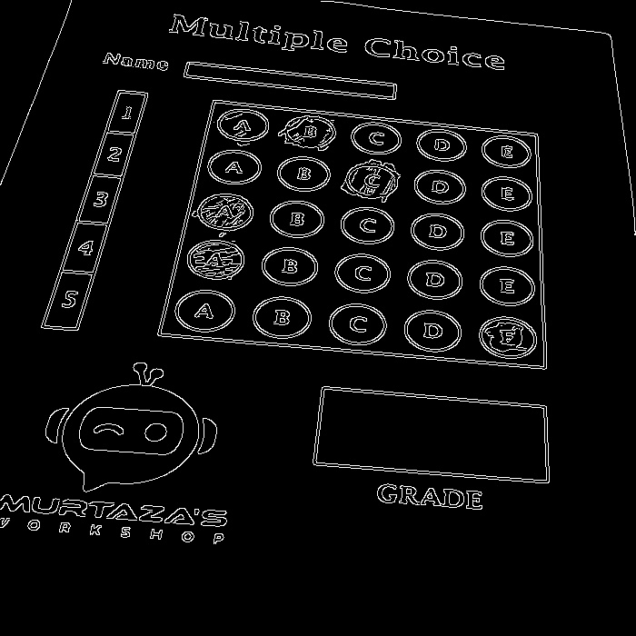
Blurred image
Canny image

Slide 7
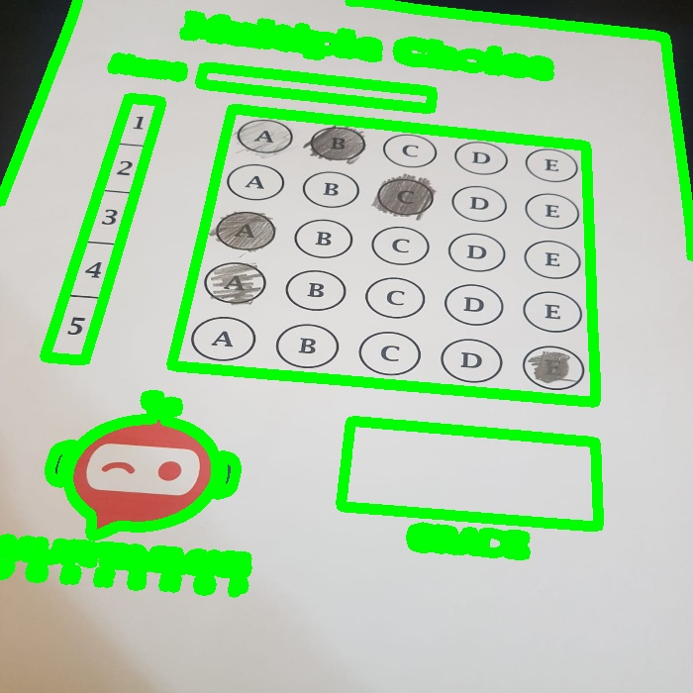
Canny image
Contour image

Slide 8

Contour Analysis

Slide 9
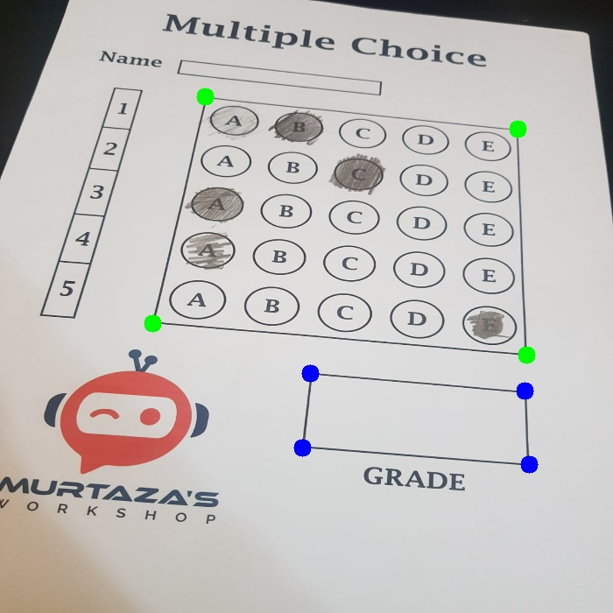
Find Rectangles
We detected rectangular regions, like answer sheets, by simplifying the shapes found in the image using the 'polygon approximation method.' This technique helped us find shapes with four sides, resembling rectangles. . Then, we marked and located their corners for a closer look.

Slide 10

Perspective Transformation

Slide 11
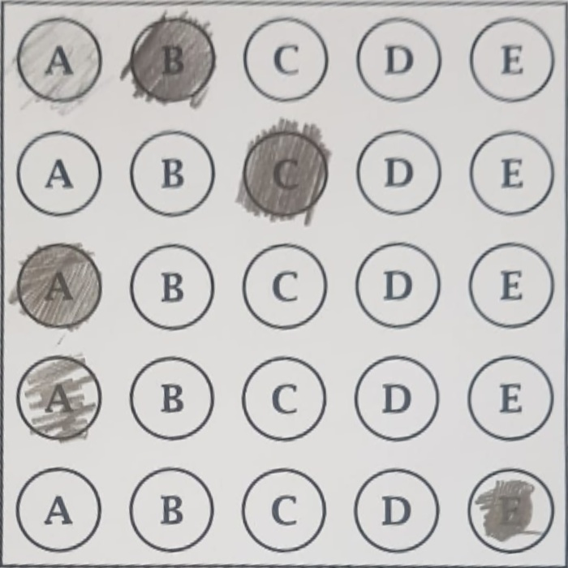
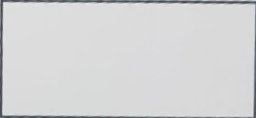
Grade and answer boxes are identified
answer boxes
grade boxes

Slide 12
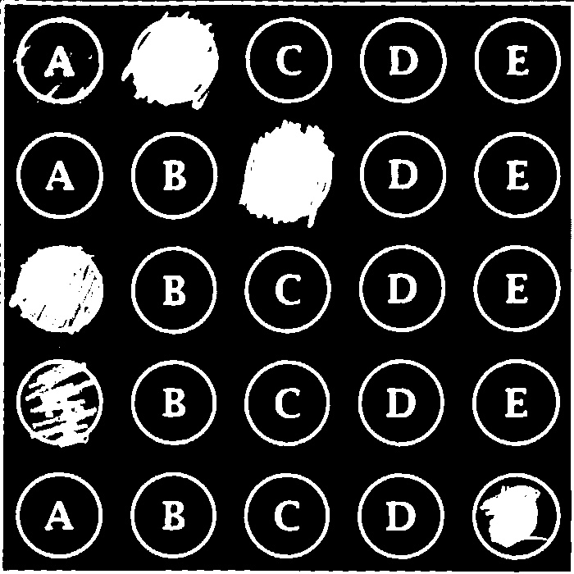
answer boxes
Threshold image

Slide 13
Identifying the Selected Answers
Analyze the non-zero pixels to ascertain the chosen options.
Assign an index value representing each selected answer per question in the test.

Slide 14
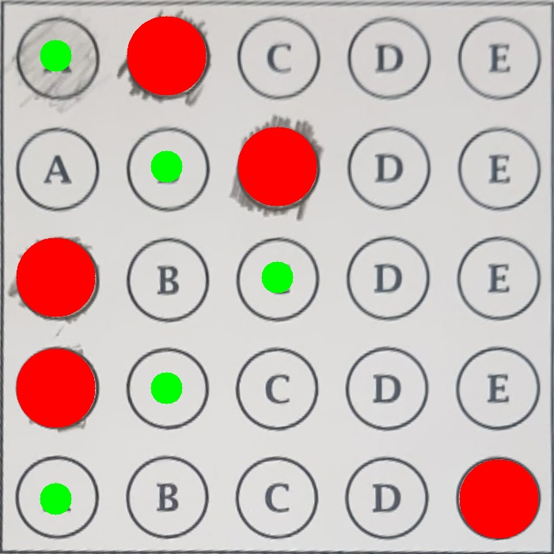
Comparing Selected vs. Correct Answers
Validate the chosen options against the correct answers
Evaluate the correctness of each response to determine the score.
Calculate the total score based on the number of correct responses.
Assign points for each accurate answer to generate the overall grade

Slide 15
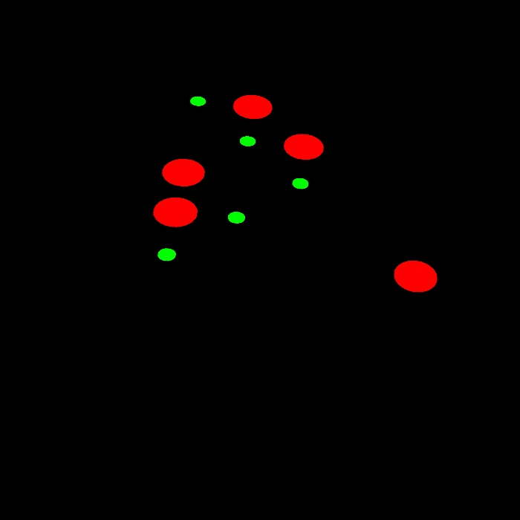
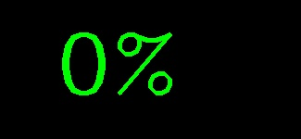
Once the grading is complete, combine the results with the corrected answers for visualization purposes.

Slide 16
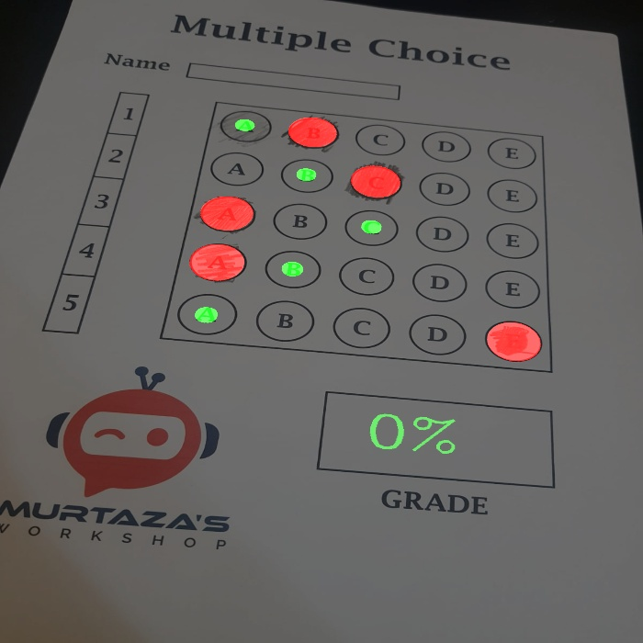
Final Result

Slide 17

Thanks!
Any questions?

